Slide 1
LOCATION NAME HERE

Slide 2
56 locations. 25 countries. 5 CONTINENTS.

Slide 3
WORLD IA DAY IS SUPPORTED by
We work to make the world’s information clearer
and easier to use by improving how people learn,
practice, and teach information architecture.
Become a member today at iainstitute.org/join Currently $10 off any membership level!

Slide 4
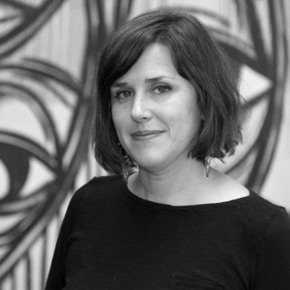

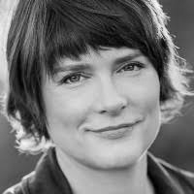


ia institute board of directors
Dan Klyn
President
Lara Fedoroff
Director of Communications
AMY ESPINOSA
Director of Operations
SAM Raddatz
Director of Events
KRISPIAN EMERT
Director of Education
Judy Siegel
Director of Development
Rachael hines
Director of Strategic Projects

Slide 5


Vote for IAI board nominees
Become a member at iainstitute.org/join You will receive a ballot via email soon after Voting closes February 27

Slide 6





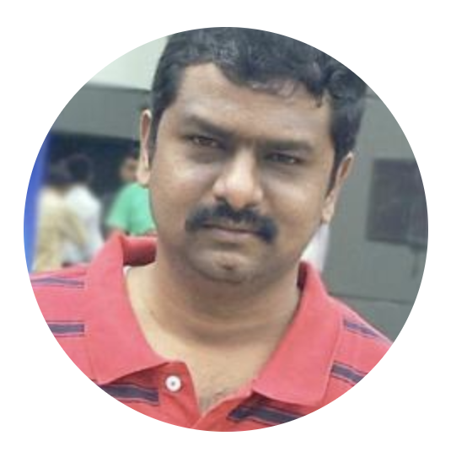

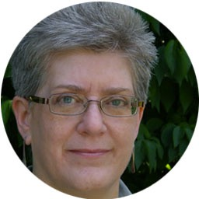
WIAD GLOBAL LEADERSHIP TEAM
CHEriANA GRIGGS
Social Media Director
evgeni minchev
Executive Producer
GRACE LAU
Web Administrator
JOSE RENE GUTIERREZ
Regional Director
SIMON ARRAJ
AV Director
SHASHANK MANDA
Regional Director
SIMON CATFORD
Regional Director
Whitney Quesenbery
Accessibility Director

Slide 7
WE are committed to your safety
The Board of Directors of the Information Architecture Institute have drafted a code of conduct to be agreed to and upheld by any member of the global and local volunteer teams. This code of conduct applies to all volunteers, all locations, all attendees, and all speakers of World IA Day.
We do not tolerate harassment of participants, speakers or volunteers in any form.
We are listening: safety@worldiaday.org
worldiaday.org/code-of-conduct

Slide 8

WORLD IA DAY 2018 WELCOME VIDEO

Slide 9
[ location welcome slides… ]

Slide 10
[ some other slides you might find useful… ]

Slide 11
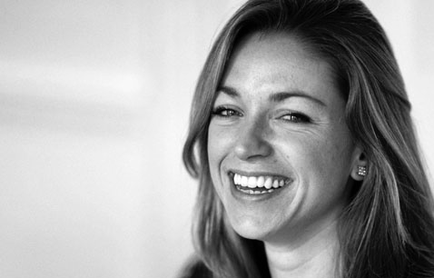
THANKS TO OUR LOCAL VOLUNTEER TEAM
Add your team…
Name
Title
NAME
Title
NAME
Title
Name
Title
Name
Title
NAME
Title

Slide 12
THANKS TO OUR local SPONSORS

Slide 13










THANKS TO OUR GLOBAL SPONSORS

Slide 14
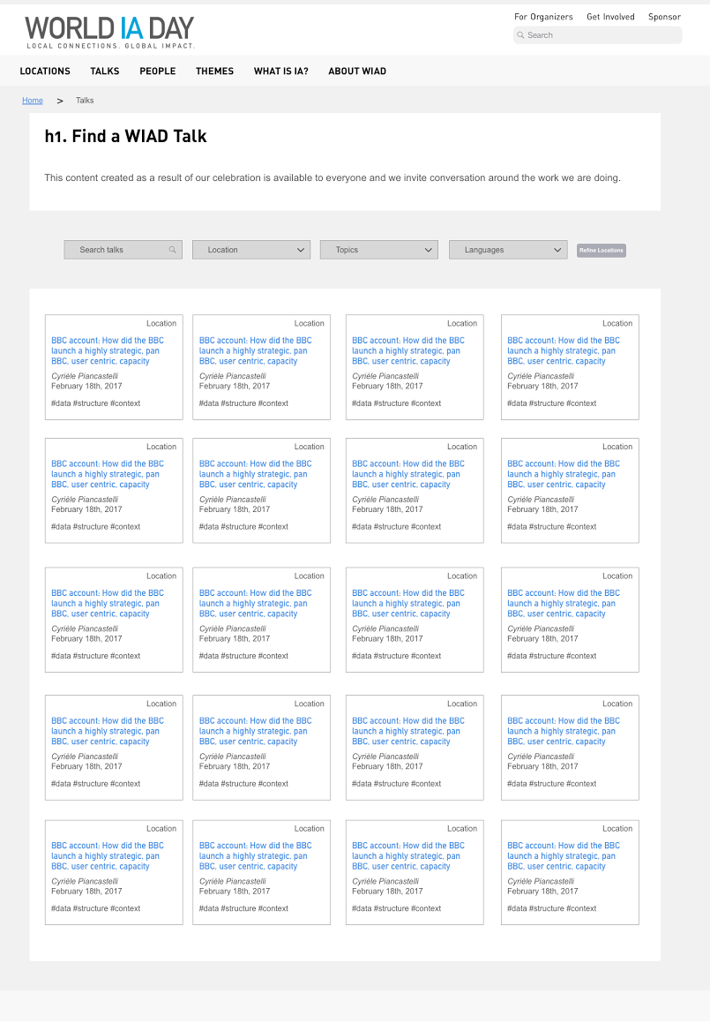

Coming Soon: World IA Day Archive
This spring, the global WIAD team is launching an online archive of past WIAD talks to preserve the knowledge shared around the world on WIAD and make it available as an on-demand global resource. The archive is designed to be a collaborative community resource for IA veterans and new practitioners alike, and will be FREE to everyone.
Created by our global team in collaboration with our sponsor, The Understanding Group, and our partner Agile Collective, this archive will help more people learn what we already know—that the practice of information architecture has the power to improve the way we organize, share, and understand our world.
Sign up to be notified when the archive launches at bit.ly/WIADarchive

Slide 15
GREAT GIVEAWAYS FOR ALL ATTENDEES AT
bit.ly/wiad18swag
Free 48 hour access to the All You Can Learn Library
The UIE All You Can Learn Library allows you to watch, listen, and learn from the world's best UX experts.
20% off any order!
Receive 20% off any purchase from Rosenfeld Media through our exclusive offer code.
60-day full featured licenses!
With this 60-day full license you can create fully-interactive high-fidelity prototypes that look exactly like your app should. No coding required.

Slide 16
GREAT GIVEAWAYS FOR ALL ATTENDEES AT
bit.ly/wiad18swag
20% discount
Learn how to transform your company through Cooper's design and leadership courses in San Francisco and New York. Or bring our corporate training and coaching to you.
$10 Off Memberships
Join the only organization focusing on making the world's information clearer and easier to use by improving how people learn, practice and teach information architecture.
$50 Off A Ticket
IA Summit takes place March 21-25, 2018 in Chicago, Illinois, USA. The IA Summit is the preeminent professional conference on how to create and manage information spaces.

Slide 17
Raffle prizes – Awesome tools!
30 days free - One per location
One lucky winner will receive 30 days of unlimited use of Optimal Workshop tools.
Free Sketch License - One per location
One lucky winner will receive a free license for Sketch.
Free Axure License - One per location
One lucky winner will receive a free license for Axure.
Free proto.io 1-year freelancer plan - One per location
One lucky winner will receive a free 1-year freelancer plan for proto.io.

Slide 18
Raffle prizes – Great Digital BOOKS!
Full digital library - One per location
One lucky winner receives a complete set of all Rosenfeld Media books published to date. The winner gets to choose from four digital formats (PDF, ePub (for iPad), MOBI (for Kindle), and DAISY).

Slide 19
official hashtag: #WIAD18

Slide 20
WIFI INFO
Enter Credentials here

Slide 21
TODAY’S AGENDA
XX:XX AM - XX:XX AM Opening Remarks by Organizer Name
XX:XX AM - XX:XX AM Session 1 by Speaker Name
XX:XX AM - XX:XX AM Session 2 by Speaker Name
XX:XX AM - XX:XX AM Session 3 by Speaker Name

Slide 22
[ closing slides… ]

Slide 23
SEE YOU NEXT YEAR!

